Slide 1
HUMAN COMPUTER INTERACTION LECTURE 1

Slide 2
Outline
Introduction to HCI
Alarm Clock Example
Dos time versus software application
Don Norman’s Door Example
The human
Information i/o …
visual,
auditory,
haptic,
movement

Slide 3
Goals of HCI
Useful
Accomplish what is required
Play music, cook dinner, format a document
Usable
Do it easily and naturally
Without danger of error
Used
Make people want to use it
Be attractive, engaging, fun

Slide 4
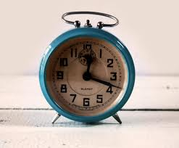
Alarm Clock

Slide 5
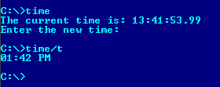
DOS TIME

Slide 6
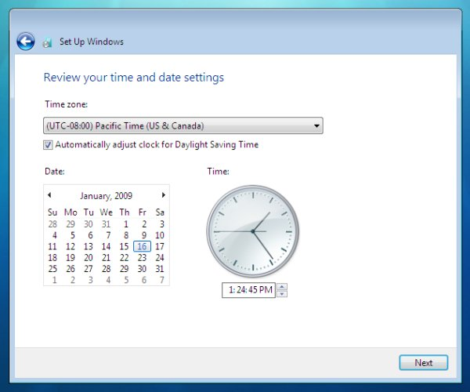
Why Study HCI – Software Perspective

Slide 7
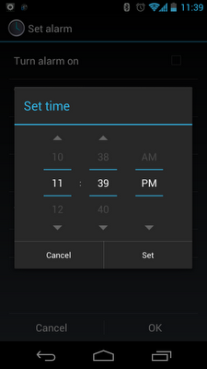
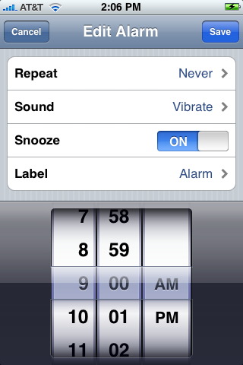
Smart Phone Clock

Slide 8
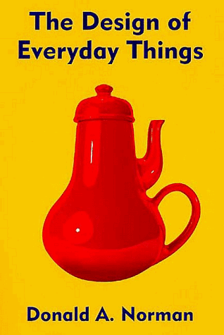
Don Norman’s Door Example
A classic book. Read it!
Main Point: no one reads manuals, so things should be designed so that manuals are not needed
what is wrong with the kettle on the book cover?

Slide 9
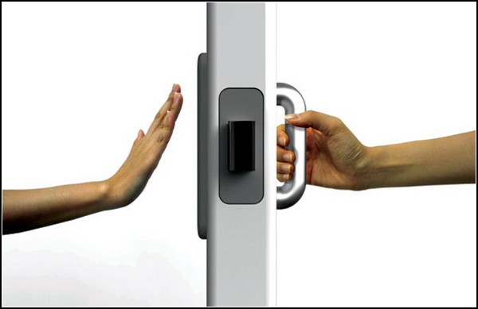
Don Norman’s Door Example
A plate naturally says “ push me” and a handle naturally says “pull me “

Slide 10
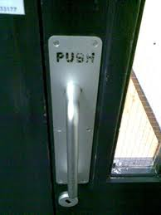
Don Norman’s Door Example
When Don Norman’s advice is not followed

Slide 11

Vision
Two stages in vision
• physical reception of stimulus
• processing and interpretation of stimulus

Slide 12
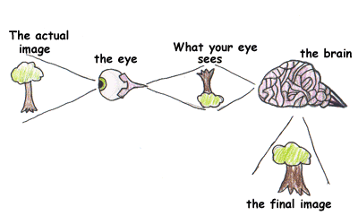
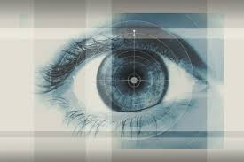
The Eye - physical reception
mechanism for receiving light and transforming it into electrical energy
light reflects from objects
images are focused upside-down on retina
retina contains rods for low light vision and cones for colour vision
ganglion cells (brain!) detect pattern and movement

Slide 13
Interpreting the signal
Size and depth
visual angle indicates how much of view object occupies (relates to size and distance from eye)
visual acuity is ability to perceive detail (limited)
familiar objects perceived as constant size (in spite of changes in visual angle when far away)
cues like overlapping help perception of size and depth

Slide 14
Interpreting the signal (cont)
Brightness
subjective reaction to levels of light
affected by luminance of object
measured by just noticeable difference
visual acuity increases with luminance as does flicker
Colour
made up of hue, intensity, saturation
cones sensitive to colour wavelengths
blue acuity is lowest
8% males and 1% females colour blind

Slide 15
Interpreting the signal (cont)
The visual system compensates for:
movement
changes in luminance.
Context is used to resolve ambiguity
Optical illusions sometimes occur due to over compensation

Slide 16
Optical Illusions
the Ponzo illusion
the Muller Lyer illusion

Slide 17
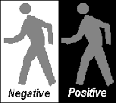
Reading
Several stages:
visual pattern perceived
decoded using internal representation of language
interpreted using knowledge of syntax, semantics, pragmatics
Reading involves saccades and fixations
Perception occurs during fixations
Word shape is important to recognition
Negative contrast improves reading from computer screen

Slide 18
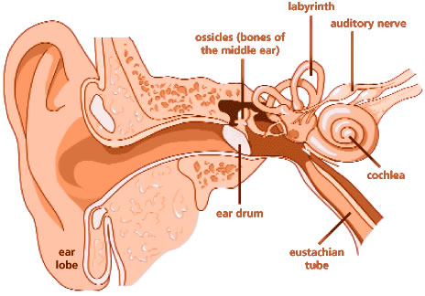
Hearing
Provides information about environment: distances, directions, objects etc.
Physical apparatus:
outer ear – protects inner and amplifies sound
middle ear – transmits sound waves as vibrations to inner ear
inner ear – chemical transmitters are released and cause impulses in auditory nerve
Sound
pitch – sound frequency
loudness – amplitude
timbre – type or quality
Notes:
Outer ear: Pina

Slide 19
Hearing
Outer Ear
Parts: Pinna (the visible part) + ear canal
Purpose:
Collects sound waves from the environment.
Amplifies certain frequencies (makes them louder) before sending them to the middle ear.
Protects the inner parts from dust, water, and injury.
Notes:
Outer ear: Pina

Slide 20
Hearing
Middle Ear
Parts: Eardrum (tympanic membrane) + three tiny bones called ossicles (malleus, incus, stapes)
Purpose:
Transmits sound from the outer ear to the inner ear.
Converts sound waves into vibrations.
Amplifies these vibrations so they are strong enough for the inner ear.
Notes:
Outer ear: Pina

Slide 21
Hearing
Inner Ear
Parts: Cochlea + auditory nerve
Purpose:
The cochlea turns the vibrations into electrical signals.
Tiny hair cells in the cochlea detect different frequencies.
Signals are sent to the brain via the auditory nerve,
which interprets them as sound
.
Notes:
Outer ear: Pina

Slide 22
Hearing (cont)
Humans can hear frequencies from 20Hz to 15kHz
less accurate distinguishing high frequencies than low.
Auditory system filters sounds
can attend to sounds over background noise.
for example, the party phenomenon.

Slide 23
Hearing (cont)
Frequency | Examples of Sounds | Type / Description
Low Frequency | Drum, Bass Guitar, Tuba, Piano (lower keys), Elephant rumbles, Whale sounds, Male human voice | Deep, heavy, slow vibrations; easy to detect
Mid Frequency | Piano (middle keys), Female human voice, Most speech sounds, Dog bark | Moderate pitch; human speech is mostly here
High Frequency | Flute, Piccolo, Violin (high notes), Cymbals, Birds chirping, Whistle, Insects (crickets), Squeaky toys | High-pitched, fast vibrations; harder to distinguish precisely

Slide 24
Hearing (cont)
Frequency | Hearing Characteristic
Low (20–500 Hz) | Deep sounds like drum, bass; ear can detect them but less sensitive than mid-range, need higher intensity sometimes.
Mid (2–5 kHz) | Human speech; ear is most sensitive; even quiet sounds are easily detected.
High (>5 kHz) | Tones like whistle, birds chirping; ear is less accurate; hard to distinguish small differences.

Slide 25
Touch/Haptic
Provides important feedback about environment.
May be key sense for someone who is visually impaired.
Stimulus received via receptors in the skin:
Thermo-receptors – heat and cold
nociceptors – pain
mechanoreceptors – pressure (some instant, some continuous)
Some areas more sensitive than others e.g. fingers.
Kinesthesis - awareness of body position
affects comfort and performance.

Slide 26
Movement
Time taken to respond to stimulus: reaction time + movement time
Movement time dependent on age, fitness etc.
Reaction time - dependent on stimulus type:
visual ~ 200ms
auditory ~ 150 ms
pain ~ 700ms
Increasing reaction time decreases accuracy in the unskilled operator but not in the skilled operator.

Slide 27
Movement (cont)
Fitts' Law describes the time taken to hit a screen target:
Mt = a + b log₂(D/S + 1)
where: a and b are empirically determined constants
Mt is movement time
D is Distance
S is Size of target
targets as large as possible distances as small as possible

Slide 28
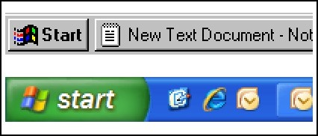
Fitts law
Fitts law is useful for web designers when deciding where to place the next button
Call to Action Buttons , links and other buttons can be strategically placed on websites/apps to increase the chance of clicking. Not only do you want to direct traffic to the right places, but users need to a have a simple and easy experience. Notice how the windows start button almost doubled in size?

Slide 29
Summary
Today we learnt about,
Basics of Human Computer Interaction
Alarm Clock Example
Dos time versus software application
Don Norman’s Door Example
The human
Information i/o …
visual,
auditory,
haptic,
movement

